Slide 1
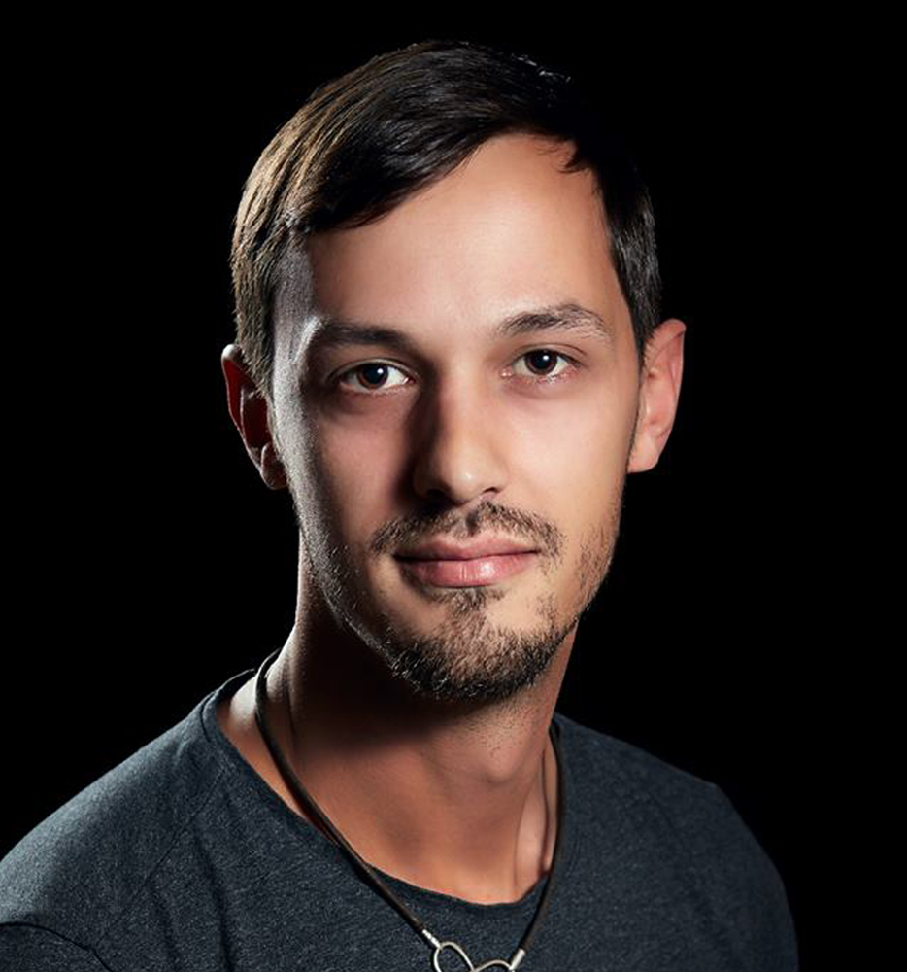
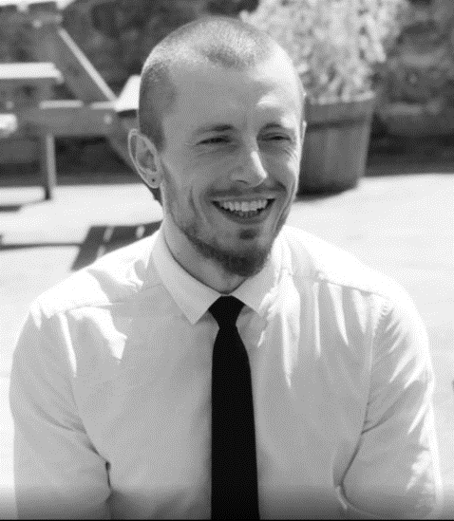
Who we are? Go2games.com
Craig Constantinides
craig@go2games.com
DIRECTOR
Josh Mansell
josh@go2games.com
DIRECTOR

Slide 2
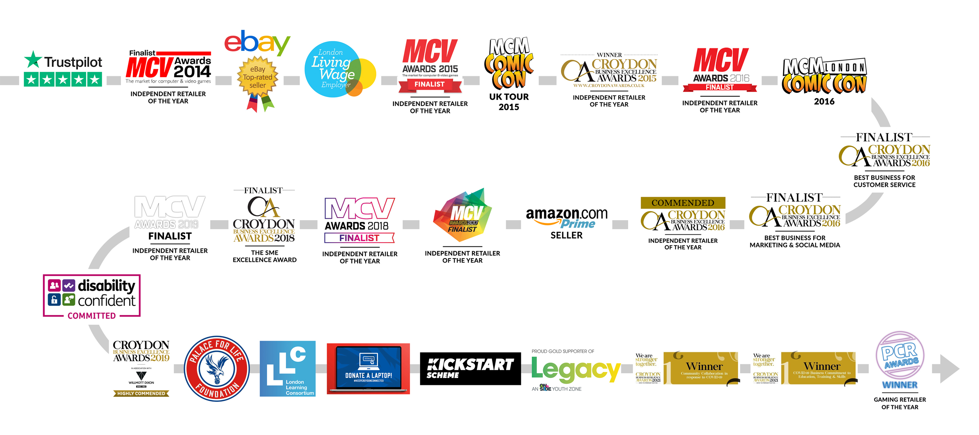
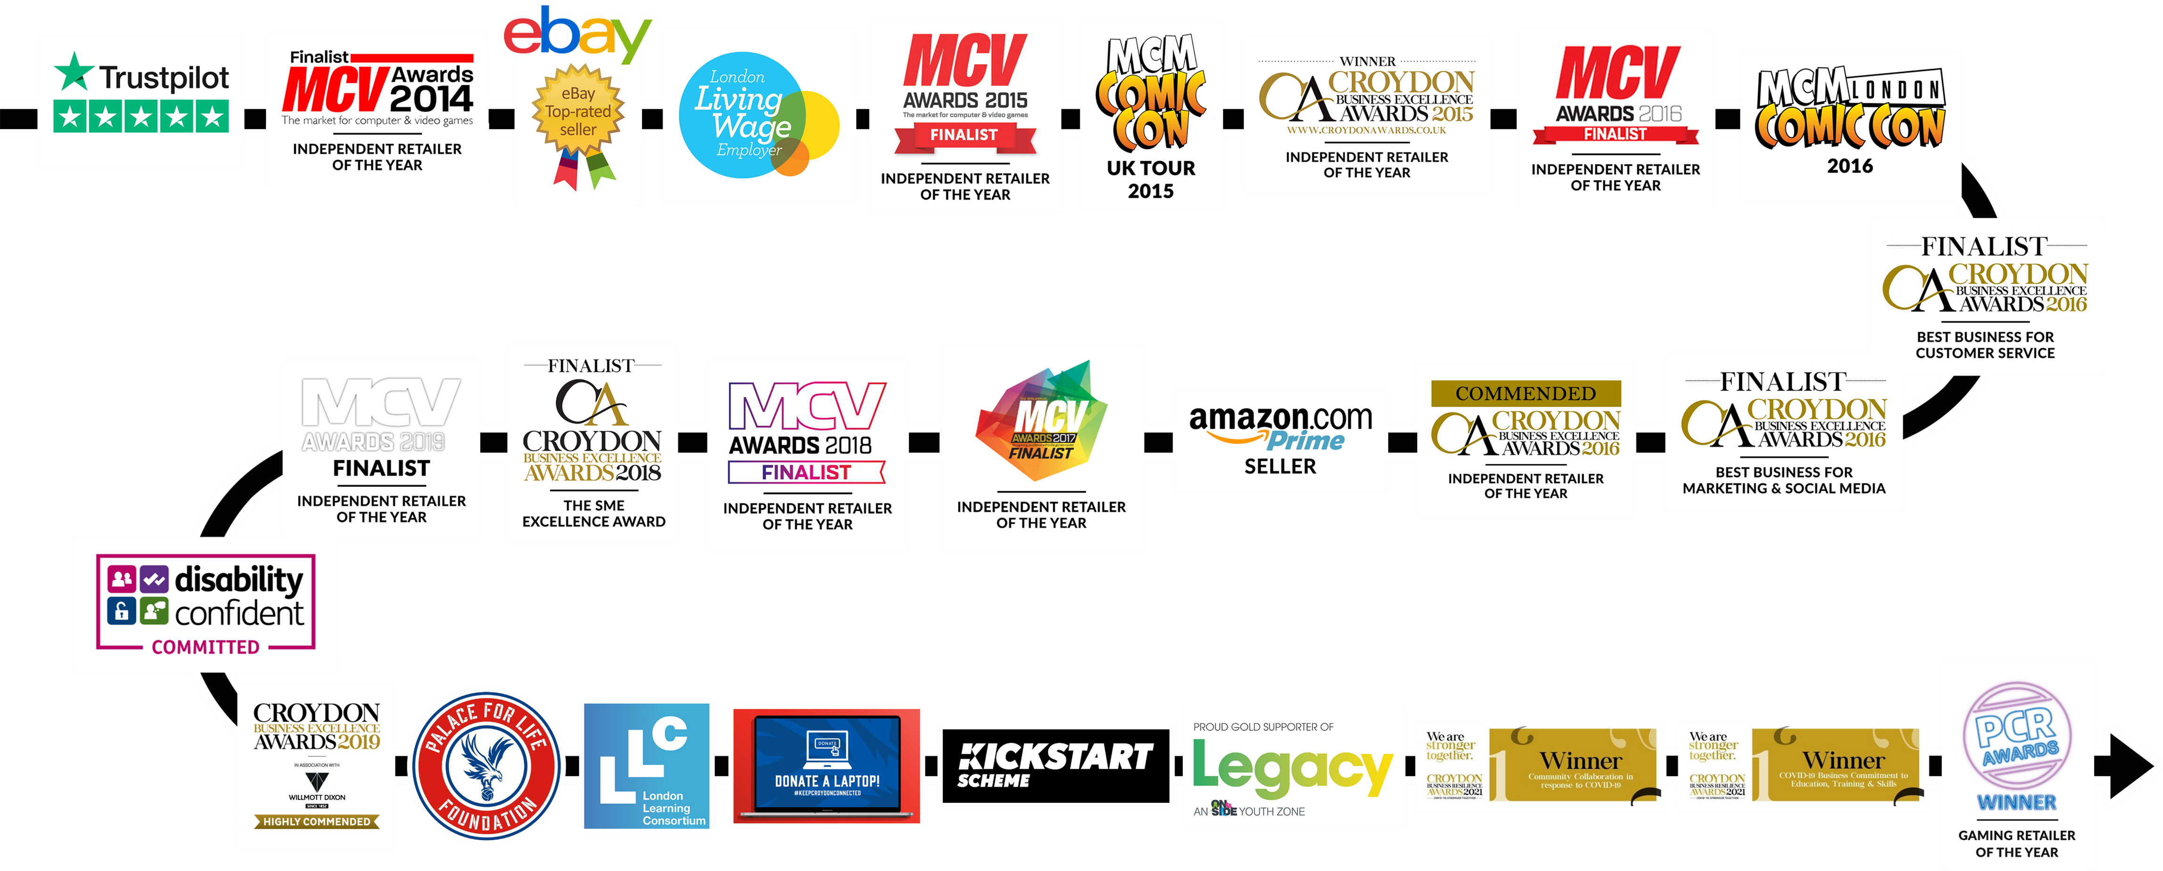
Notes:
Spend some time reading through the blurb in the black.
Talk about the journey we have had with awards and different moments during the time since 2012.
Allow students to ask any questions for a couple of minutes but do stop it if the questions get too much or off task.

Slide 3
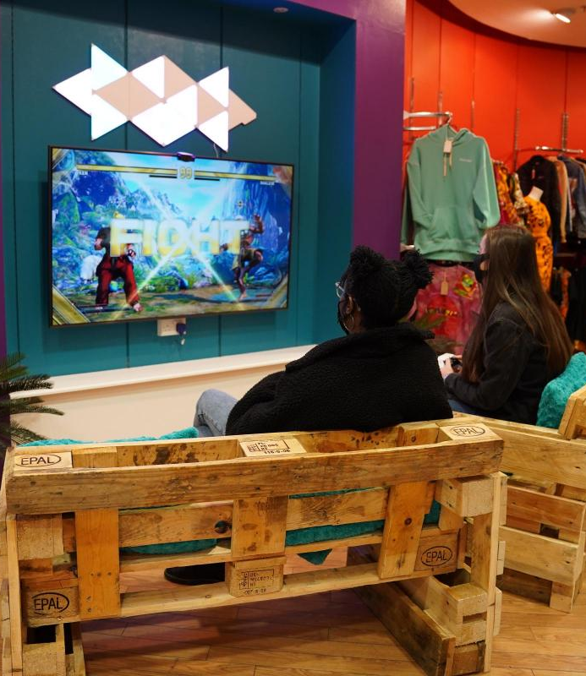
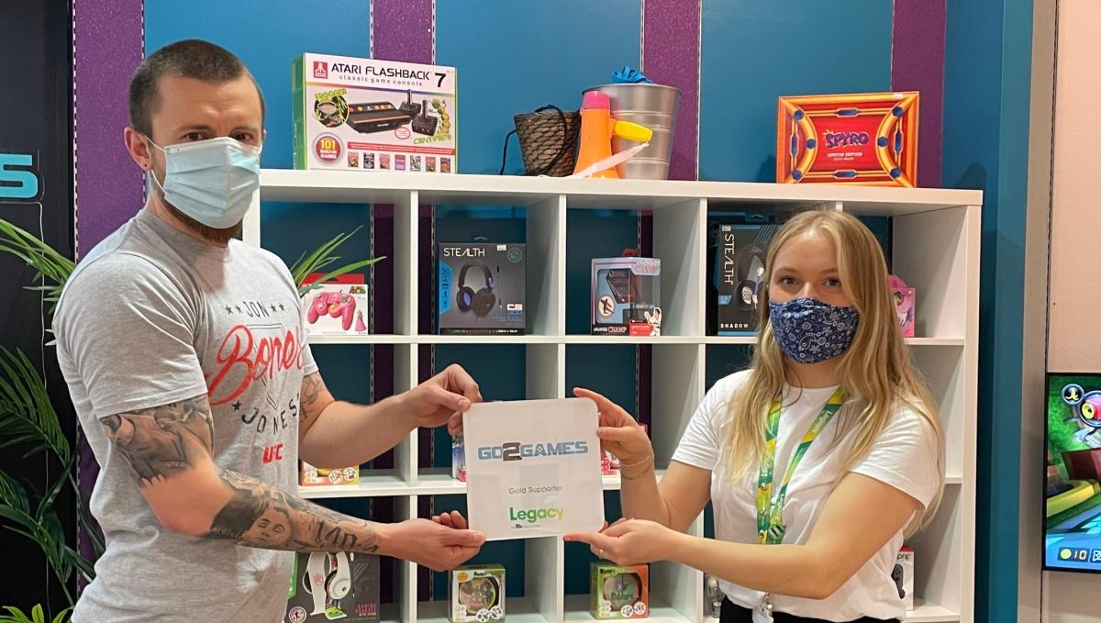

Slide 5
Levels Learning & Recruitment was founded through a desire for change. It was established by a team with experience in business, education and social welfare. The goal is to create a system that removes the unconscious bias from the employment selection process and up-skill talent to better serve the needs of their local economy.
Working with local and national partnerships, we’ve crafted a holistic journey with programmes and extended care packages that we believe are a true game-changer.
Thank you so much for your interest in LEVELS.
Craig, Josh & Sean

Slide 6
The Levels Group is a tapestry of projects that are already in production or in pre-flight. Each project will serve to address issues collaboratively and provide opportunities for partnership in order to spotlight issues and tackle them as a community.
It’s a mindset.

Slide 7
There are Levels to this.
The Levels group has a number of live projects with more planned to come.
Levels Learning.
Working with local and local national partnerships - upskilling local People for local Jobs.
Levels Recruitment.
AI skills-led recruitment - Assisting in removing unconscious bias from the selection process for interview.
Levels Fashion.
A CIC working with student partnerships to create community conscious fashion.

Slide 8
There are Levels to this.
The pillars that give us our purpose.
Hope.
Through interaction with The Levels Group our aim is to instil hope in our customers by improving current and future career prospects.
Understanding.
Levels aims to help businesses better understand the needs of employees with different abilities, and to modify their workplaces accordingly. We inspire positive and sustainable cultures to get people into work and keep them there.
Opportunity.
Created through varying levels of support and a holistic approach to skills training and recruitment to increase positive outcomes for both job-seekers and employers.

Slide 9
Why Now?
“Universal credit cuts. Job-Seekers told to widen search or face cut.”
-BBC News.
“The UK has more job vacancies than unemployed people for the first time
as businesses continue to post job adverts, out of work candidates are in short supply.”
-Office for National Statistics.
“Across all education and income levels, what we saw is that over half of workers want to upskill, but awareness of what exactly to do was one of the biggest barriers.”
-Future of work analyst Kweilin Ellingrud.
“The skills required in the workforce are changing fast. Jobs are changing on you, even if you’re not changing jobs.”
-Linda Cai, vice-president of talent development at LinkedIn.

Slide 10
How big is this?
£772 BILLION*
Global recruitment market.
-Fortune Business Insights
76%
Gen Z seeing learning as the key to their advancement.
-Forbes.
40%
of recruiters on LinkedIn rely on skills data to find talent.
-BBC Worklife.
25%
Change in skillsets for jobs since 2015.
-LinkedIn Data.

Slide 11
Our aim is to supplement the recruitment market, providing opportunities for jobseekers to upskill, feel empowered and increase confidence in their own abilities bringing them closer to local job markets.
Our growing employer network will also be provided with continued access to training opportunities for new and existing employees.

Slide 12
The Problem for Jobseekers.
Good work-life balance.
A healthy balance is paramount importance when jobseekers are searching for suitable roles. Flexibility and a range of support measures and employee benefits have strong impacts on staff retention. Trends that affect workplace culture such as remote working arrangements all play their part in forming working routines that suit our ever-busier lifestyles.
Access to training.
Having consistent access to training in order to upskill existing staff members has a significant impact on staff’s overall satisfaction and feeling of self-worth. Ensuring the development and capabilities of staff improves overall efficiency, and retention benefits both the business and those employed within it.
A living wage.
Wage increases to combat rises in inflation also have a significant impact on staff retention and overall satisfaction and feeling valued. This is inclusive of minimum wages and living wages keeping step with rising prices to ensure employees are not left out of pocket when providing for themselves and their families.
Localised discovery.
The ability for jobseekers to find local jobs not only significantly affects retention, but also has a marked effect on local community investment and a positive impact on sustainability and the environment. An effective localised network and the ability to find suitable positions are of paramount importance.

Slide 13
The Problem for Businesses.
Retention crisis.
Businesses are still very much battling retention issues, as talent continues to move between companies at pace.
In the last six months alone, one
in ten workers said they had
quit their jobs, resulting in the
highest UK quit rate since 2009.
Skill gaps.
There is a continued gap between the expectation of skills required by employers and jobseekers.
These hard and soft skills include teamwork, public speaking, critical thinking and problem solving, leadership and communication.
Job satisfaction.
Company culture and meaningful employment within organisations is paramount for staff retention, with employees seeking a healthy work-life balance.
The proportion of people who are happy in their jobs in the UK has decreased by 10% in the last three years, with rates falling to 64% in 2019, compared to 74% in 2016.
Unconscious bias.
Creates a lack of diversity in workplaces. During the hiring process employers are not able to fill positions with the correct candidate due to various biases including those pertaining to ageism, gender, ethnicity and appearance. This has a detrimental effect on company culture and businesses’ ability to grow and maintain staff.

Slide 14
We are the solution. We can prove it.
Previous program impact.
Real working experiences provide the best learning environments.
We elevate jobseekers by upskilling and providing training to people from all backgrounds.
We provide a holistic support journey and are committed to a lifelong learning mindset to expand opportunities and future employment prospects.
100% receiving interviews.
Based on 98 Learners.
100% work experience completion.
Between June 2022 and December 2022.
67% gain further opportunities.
Surveyed cohorts felt they gained relevant tools to further their career.
33% into full-time employment.

Slide 15
How they win.
Previous programme impact.
Enterprise skills.
Each learner has the opportunity to develop enterprise and entrepreneurship skills and discover how they are transferable to excel in any career.
Free for all learners.
The aim is for people from any background who are currently unemployed to experience the Elevation Programme completely free of charge.
NCFE Level 1 business qualification.
Learners will gain a Level 1 certificate in business to bolster employment prospects and growth opportunities by assisting in removing barriers to further education and training.
CV workshops / LinkedIn training / interview skills.
Learners will complete the Programme with updated CVs and profiles, an understanding of how to use different forms of social media to further their careers, and greater confidence in interviews.
Work experience and reference.
A recent work experience and reference play a vital part in ensuring learners have the best opportunity for success in interviews.
Post-programme care.
We understand the importance of flexibility within the workplace and the need to create longer-tail holistic journeys for both learners and businesses. Our post-programme care package provides up to 12 months of additional support.

Slide 16
The Levels recruitment model.
CUSTOMER SIGN UP
From various sources including job centre referrals.
RECRUITMENT
Learners are assessed, given an ai ranking and provided with multiple employment opportunities that match their ambitions and skillset.
ADDITIONAL TRAINING
Additional training opportunities are continuously offered to allow employers to to upskill their workforce and ensure sustained positive outcomes from interacting with Levels Learning and Recruitment.
THE ELEVATION PROGRAMME
Builds confidence whilst gaining a qualification, work experience, a recent work reference and access to interviews.
PARTNERSHIPS
Various partnerships provide continued holistic support for both employers and staff post-employment to sustain satisfaction and outcomes.
CONTINUED GROWTH
All learners and employers are consistently re-engaged to assist in increasing work retention and life satisfaction.

Slide 17
Our growing list of local and national partnerships and spaces to facilitate aspirational learning, is specifically designed to assist in creating a truly holistic journey towards sustainable recruitment.

Slide 18
Holistic Journey.
Post-programme
6 months Creating opportunities.
One-to-one support with a dedicated career coach
Tailored workshops to address barriers to work
Access to further opportunities, jobs, training and apprenticeships
Financial support with personalised budget
6 months of ongoing support in new job, apprenticeship or course
12 months Optimal pathway journey.
Expert coaching workshops to invest in personal development
Committed support for employers
Access to further training opportunities
Monthly mentorship meetings
Additional support and advice post-employment
In partnership with

Slide 19
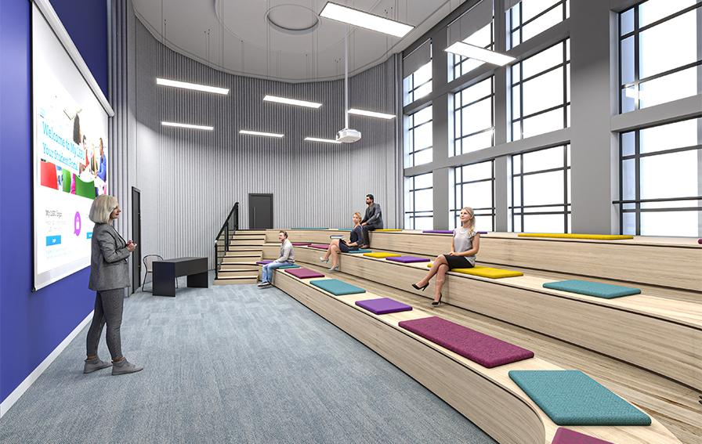
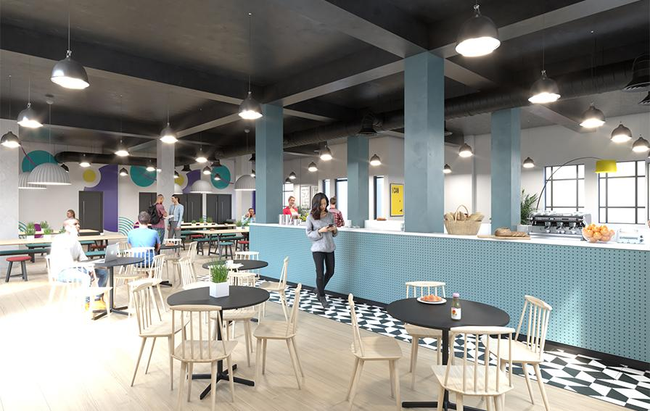
LBSU Croydon.
Our Partnership with London Southbank University allows for continued holistic development of an aspirational mindset, and for learners to interact with state-of-the-art technology in inspiring spaces. This contributes to removing institutionalised barriers within society so that we may all share equally in the benefits of strengthened communities.
Aspirational Learning partnership.
Learn more.

Slide 20
ACTION - It’s a mindset.
Produced by previous learners.

Slide 21
We’ve partnered with Sigma Polaris, using state-of-the-art AI profiling technology, refined with experts from the Universities of Bristol and Copenhagen, to understand candidates’ strengths and shortlist for particular roles.
AI-driven platform supports companies in identifying top talent in a standardised and equitable way while removing unconscious bias.

Slide 22
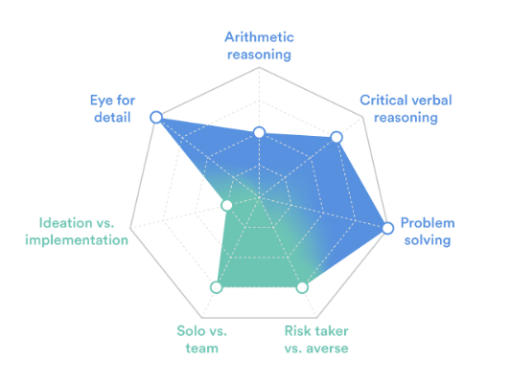
DEI - 29 cases of bias prevented per hire.
QUALITY - 5x more accurate selection process than human-only approaches.
EFFICIENCY - 90% faster candidate pre-screening.

Slide 23
How the process works.
JOB PROFILE-
You create your ‘ideal applicant’ profile.
ASSES CANDIDATES-
The system creates a unique link to the assessment based on your required profile. Job applicants take the assessment, which tests candidates against a set of hard and soft skills.
AI RANKING-
The applicants are profiled according to how close they are to your ideal applicant profile, uniquely prioritising your needs without bias.
HUMAN INTERVIEW-
You can then use the ranking and profiles to decide how to proceed and whom to invite to interview.
And you do so knowing a great deal about each applicant's ability to do your job.

Slide 24
Growing recruitment Network.
64 Letters of intent and growing.

Slide 25
Testimonial.
“Levels Elevation Programme is an excellent introduction to the world of work for young people. I’ve worked with DISENGAGED YOUNG OFFENDERS, CARE LEAVERS & FORMER REFUGEES on behalf of the DWP & the home office for over a decade.
I have referred many young people to the Levels Programme & witnessed PHENOMENAL SUCCESS with each one. They understand the needs of this client group perfectly & are able to tap into their ENTHUSIASM & POTENTIAL.”
- Ian Willard, bluetouch london cic, founder.

Slide 26
Our Roadmap.
Q1 2023
200 Customers
Continued growth of
referral network.
Q3 2023
500 Customers
Continued growth of employer network.
Additional educational experiences added.
Q1 2024
1000 Customers
Expansion of Programme
to other areas.
Q3 2025
5000 Customers
Expansion of all revenue models across UK.
Q2 2023
300 Customers
Confirmation of long-term contracts with education partners.
Q4 2023
750 Customers
App launch
Additional educational experiences added.
Q2 2024
2000 Customers
UK Expansion.

Slide 27
Funding.
Multiple forms of revenue.
Angel Investment.
We aim to work with like-minded individuals to grow our business, and specifically our programmes and recruitment network.
Businesses Hoping to Improve CSR.
By offering pledging opportunities to larger organisations who are passionate about providing opportunities to those from disadvantaged or challenging backgrounds to bring them closer to the job market.
Crowdfunding.
We aim to facilitate community-led local and national funding opportunities for the formation of appropriate steering groups to better understand the needs of local businesses and residents.
Recruitment.
Placing the correct candidates to positions will allow for sustained revenue from recruitment successes.
Government Funding.
Our range of partnerships to provide high-quality educational outcomes means we have access to local and national schemes to assist in funding our programmes.
Ecommerce & Subscription Services.
Building on our team’s experience in Ecommerce will allow for the launch of a community-focused fashion brand, providing work experience opportunities for learners, along with a monthly It’s a Mindset subscription box.

Slide 28
The Opportunity.
OUR KEY FOCUS-
-Expanding UK and increase output
-To gain a min 0.25% of UK recruitment market
-Increase customer base to 5000 by 2024
-Become the most popular hospitality and leisure app in the world
INVESTMENT-
The Levels group LTD is seeking by way of issuing share capital £2.5M
Total equity stake 10%
Minimum Investment £10K
Offering SEIS//EIS Tax deductions YES
Investment Period 1-3 Years
TARGET / PROJECTIONS
PROGRAMME EMPLOYMENT REVENUE PROFIT
2023
2024
2025
200 66 £265K £(239K)
2000 660 £2.15M £434K
5000 1650 £5.5M £3.7M

Slide 29
2022 Annual Pledges (CSR).
ELEVATION PROGRAM PLEDGE LEVELS-
17 Learners supported.
-Levels Leader
-Optional Internship Opportunity
Level 1 Bronze.
£5,000
50 Learners supported.
-Levels Leader
-Optional Internship Opportunity
-CSR Keynote content promo
.
Level 2 Silver.
£15,000
100 Learners supported.
-Levels Leader
-Optional Internship Opportunity
-CSR Keynote content promo
-VIP Community event invitations
Level 3 Gold.
£30,000
£75 Per day (£300 per learner)

Slide 30
Terms of service.
Proposal of services
Our standard proposal fee is 10% of the professional's annual salary.
Direct-hire:
Example: Considering the annual salary of $60,000
USD and our recruitment margin of 10% the total recruitment fee for the service is $6,000 USD.
Terms and conditions
The client authorizes Reclatam to represent the company in this search with four weeks of exclusivity.
The amount established includes costs of calls, agent full service, and all the expenses necessary to place the candidate for the position.
Reclatam offers a three-months guarantee per placement. If the worker leaves the company before this period, Reclatam will provide one replacement without any extra cost.
Candidates placed by Reclatam will be considered for a period of up two (2) years after Reclatam's nomination. Therefore, in the scenario of the client hiring the candidate directly within the mentioned period, the fees established will be due to Reclatam.

Slide 31
Beyond Phase One.
We feel uniquely placed to drive great change and make a genuine difference to people up and down the country.
We have big plans for the future, including more partnerships and online learning experiences.
We hope that you will join us on this journey.

Slide 32
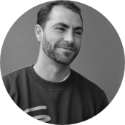
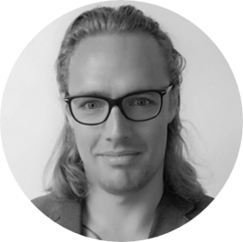
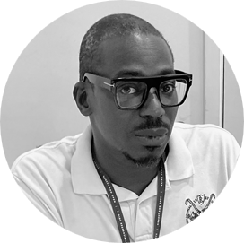
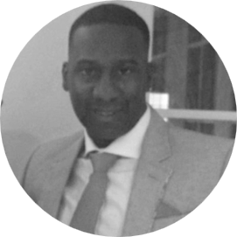
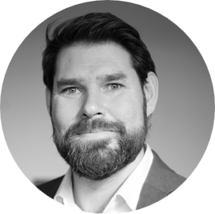
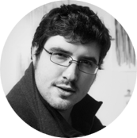
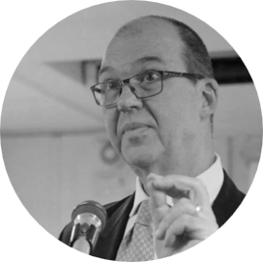
Meet our advisory team.
Joel Balkwill
-CEO of Cic Spiral Skills
-Top 100 2022 Social Entrepreneur
-10 Years Young Person Advocate In Lambeth
Rita Fiuza
-Employment Engagement Manager
-Making A Difference Programme For Education Development Trust
-Disability Confident Advocate
Nemo D’Quill
-Non-binary DEI expert
-CEO & Founder of Sigma Polaris
-World-renowned public speaker
-DR from University of Bristol
John Blackman
-Community Engagement Officer For Croydon
-Serious Violence & Exploitation Lead
-County Lines & Serious Youth Violence Reduction Advocate
David Coker
-GPS Lead At Ark Globe Academy
-Behaviour Student Development Lead
-Programme & Systems Specialist
Richard Fenn
-Director of LSBU Croydon Campus
-Community Engagement Lead
Louis Downs
-Young Enterprise Croydon Board Member Over 14 Years
-BA Hons Advertising Brand Management
-Manufacturing & Tech Entrepreneur
Colin Crookes
-MBE For Services To Disadvantaged People & The Environment
-Serial Social Entrepreneur
-CEO of Intentionality
-Author Of ‘How To Make A Million Jobs: A Charter For Social Enterprise’
Danielle Littlejohn
-MD Best Foot Forward Training
-Executive Trainer and Coach
-Promoter of confidence and capability through private, council and charity projects

Slide 33
Thank you for your time.
For any questions or further enquiries please contact us..
Josh Mansell / Managing Director
josh@levelslearning.com
Craig Constantinides / Chief Executive
craig@levelslearning.com

Slide 34
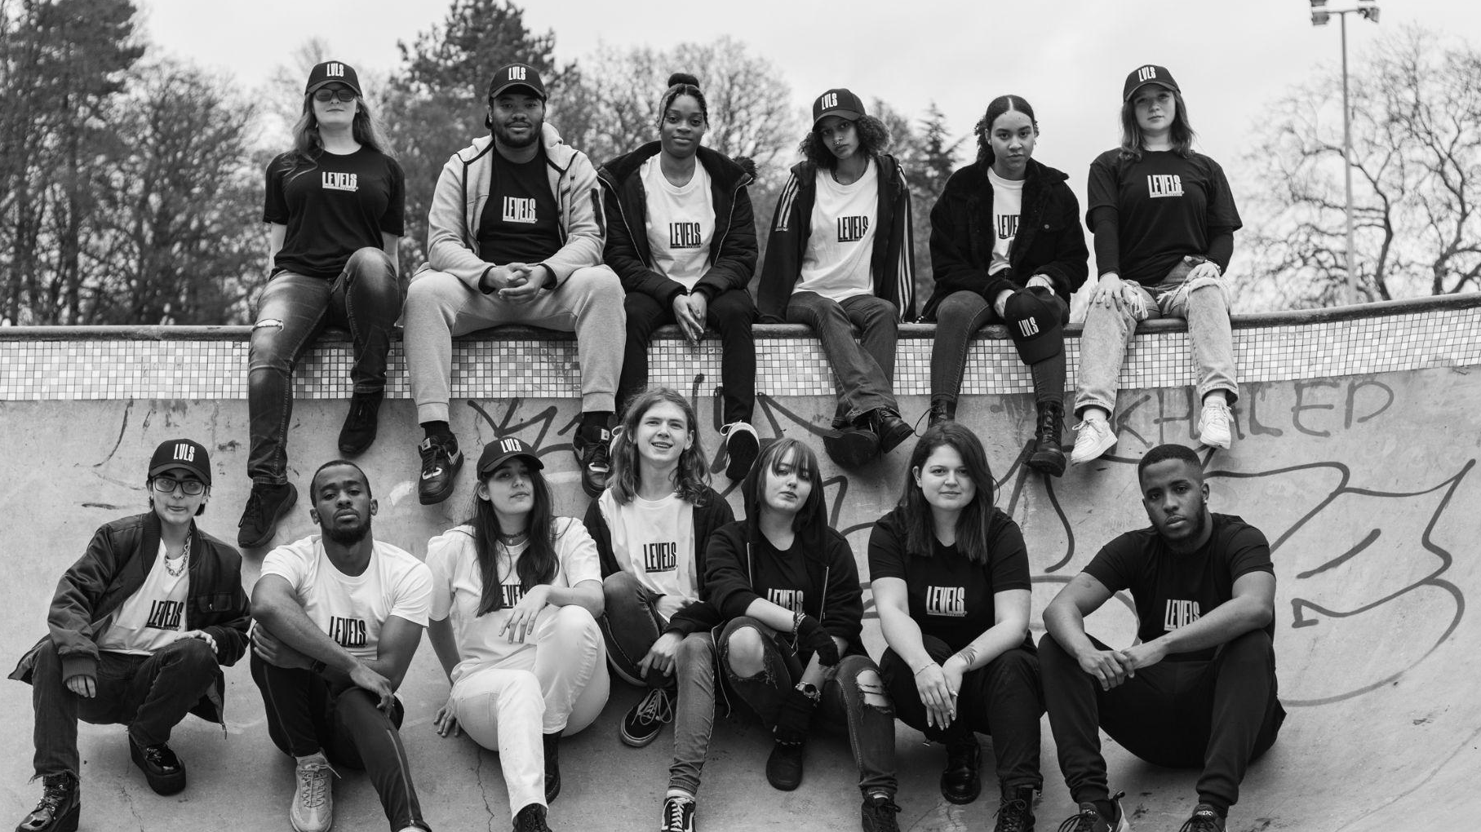

Slide 35
LEVELSLEARNING.COM
Confidentiality Statement

