Slide 1
Brian Reilly
Training Manager – Southern England brian.reilly@ncdv.org.uk
NATIONAL CENTRE FOR DOMESTIC VIOLENCE
Making domestic abuse socially unacceptable

Slide 2
DEFINITION OF DOMESTIC ABUSE
The Domestic Abuse Act 2021 defines domestic abuse as any incident or pattern of incidents between those aged 16 and over who:
Are current or former partners, are related, had or have parental responsibilities for the same child, been in a relationship of significant duration (e.g. 3 months)
The Act outlines the following behaviours as abuse:
Physical or sexual abuse
Violent or threatening behaviour
Controlling or coercive behaviour
Economic abuse
Psychological, emotional, or other abuse
It recognises children as victims in their own right who are related and who see, hear, or are impacted by the abuse.

Slide 3
NCDV specialises in obtaining:
Non Molestation, Occupation & Prohibited Steps Orders
Background:
Established 2002 by Dr Steve Connor OBE
Trained over 130,000 Police Officers,
and 5000+ McKenzie Friends
60% of referrals from Police across England
40% from DA services, local authorities,
IDVA/ISVAs and Safeguarding

Slide 4
NCDV Referrals
2022
Referrals Received | Resulted in Protective Order | Pro Bono Injunctions | % of UK Injunctions
92,438 | 10,000 | 4,000 | 39%

Slide 5
Empowerment; taking control
Speedy and flexible protection of victim and children
Improved feelings of safety and wellbeing
Clarity for workplaces, schools, and agencies such as Housing
A break, pause or an end in the cycle of abuse – usually 6-12 months
Allows victim/s space to begin long term recovery
Breaches may result in prosecution and/or custodial sentence
Civil Court – “balance of probabilities”
Referring your client is free!
Benefits of
Civil Protective Orders

Slide 6
First Steps Team
Case Assessment
Signposting
National DA Helpline
Women’s Aid Live Chat
Men’s Advice Line
LGBT Domestic Abuse Helpline
Karma Nirvana
Other services relevant to client
Family Law Act
Court Bail
DVPN/DVPO
Existing Solicitor
Association
On Notice
Perpetrator IS aware
Without Notice
(Emergency Application)
Perpetrator NOT aware
Client Pathways
Abusive activity in the last 10 days

Slide 7
How much does it cost?
Costs for a Non-Molestation Order
and our Charging Policy
Online Civil Legal Aid Calculator
There is never a charge for the work NCDV undertakes with victims to assess their case, or prepare the statement and other documentation for court.
Clients are given all options available and remain in control of each decision.
Full Legal Aid
Contributions Accepted
Contributed Legal Aid
Contributions Not Accepted
NCDV Pro Bono Team
PANEL SOLICITOR
Paperwork Only (LIP)
McKenzie Friend (LIP)
Pro Bono
Solicitor
COURT

Slide 8
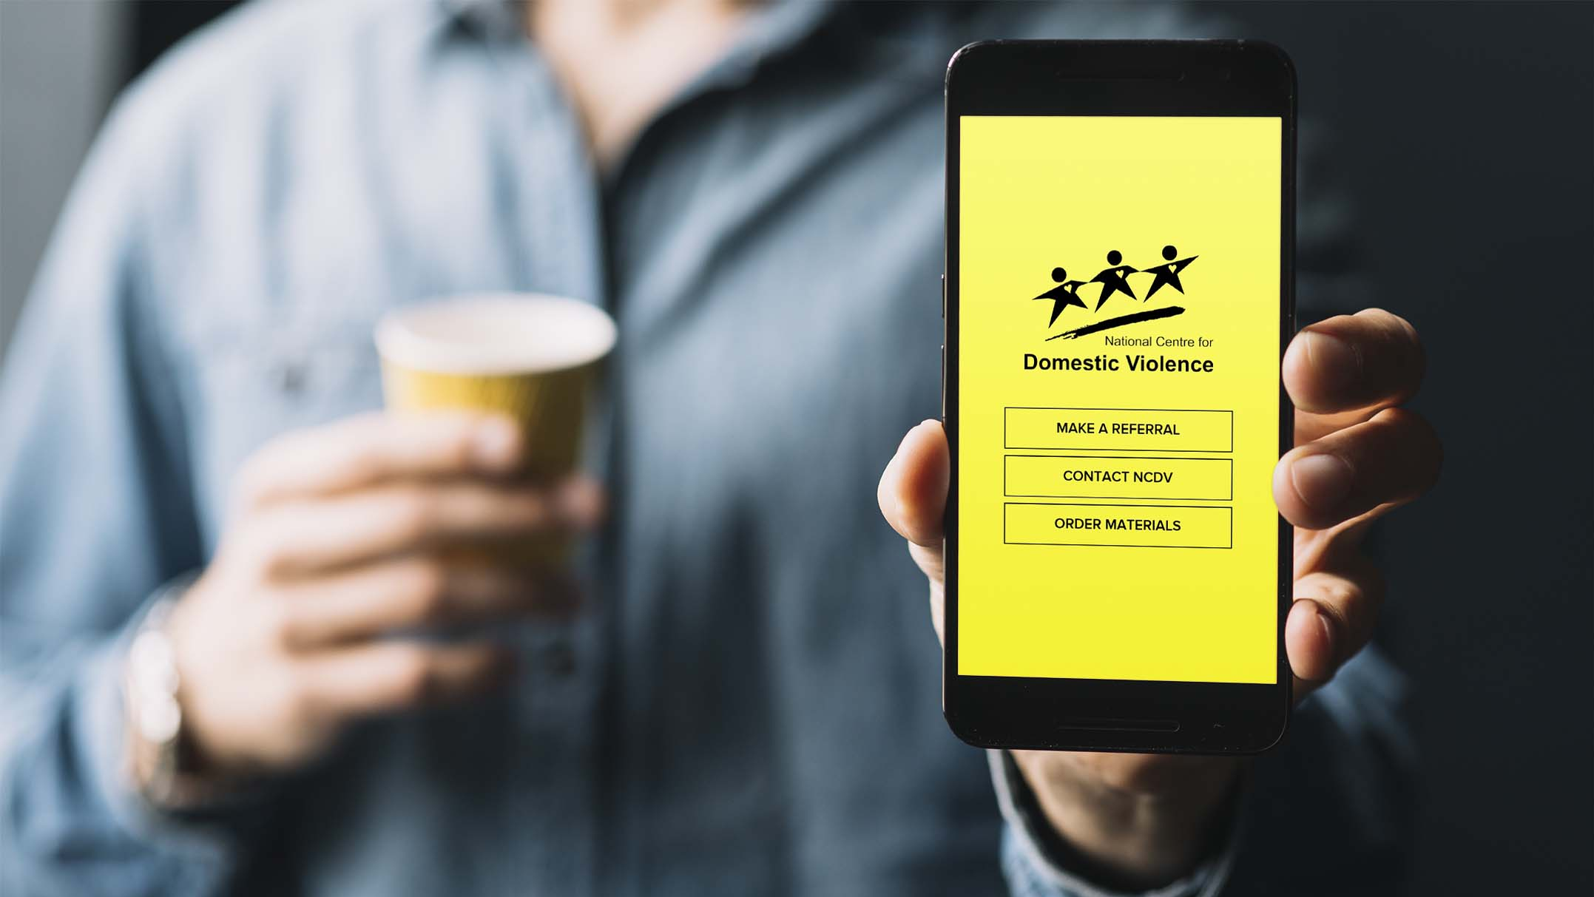
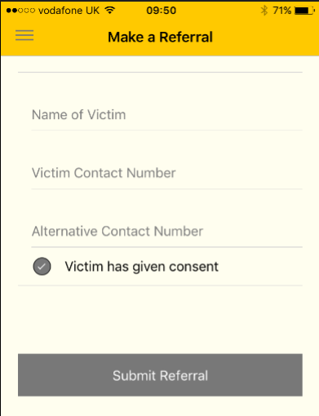
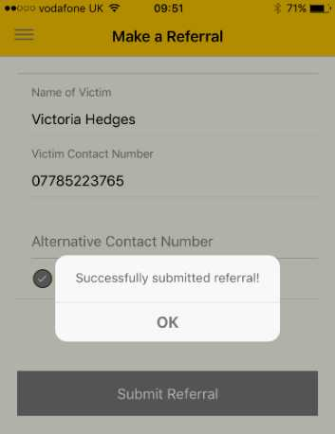
Referrals
If there has been a recent ACT or THREAT of violence contact NCDV
How to make a referral
Use the NCDV app – download for free
Online: Referdirect on www.ncdv.org.uk/
Call us 0800 970 20 70
Text NCDV to 60777
Victoria Hedges
07785 223 765
01932 576 677

Slide 9
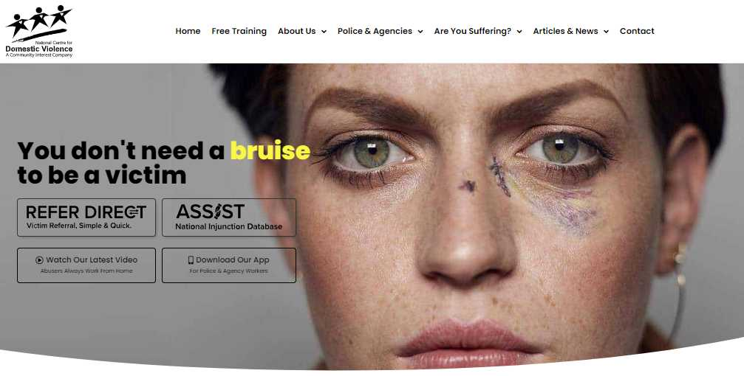
Easiest way to refer: Go to website www.ncdv.org.uk

Slide 10
ADVANTAGE
ACTION
It’s easy and fast to contact us
Contacting us
When a call is received
No time wasted to progress the order
Legal Aid assessment
Every client is assessed
Summary
Drafting the paperwork
Professional quality drafting
Going to court
Supporting the client all the way
6. Time for process
Legal protection within 24 hours
7. Investments:
Mapping Software
Assist Database
Refer Direct
App
Technical solutions for client information

Slide 11
Brian Reilly Training Manager – Southern England Email: brian.reilly@ncdv.org.uk

