Slide 1
London Youth
Introduction to the Quality Mark

Slide 2
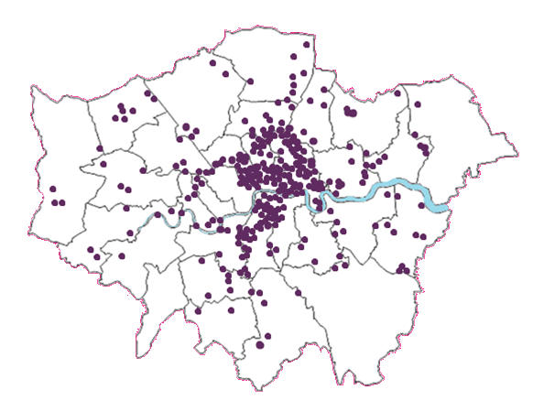
A network of over 400 youth organisations drawn from all parts of the capital

Slide 3
What is the Quality Mark?
The Quality Mark is a quality assurance framework providing your organisation with a badge of excellence. It has been designed to establish a recognised level of quality across any group/organisation that is delivering youth work.
The Quality Mark is not a “pass” or “fail” test but a way of taking your organisation on a journey to achieve and demonstrate a level of competence.
The Quality Mark is co-delivered with UK Youth and accredited by City and Guilds, the global leader in skills development & apprenticeship schemes and is recognised by local authorities and funders.

Slide 4
Quality Mark Levels
Focus on policy and procedure
Legal requirements to open responsibly
Safe and stimulating space for young people
Emphasis on personal development
Young person’s participation
Outcome for young people
Youth led
Centre of excellence
Commissioning and funding

Slide 5
Indicators
Focus on Young People
Outcomes for Young People
Safeguarding and Child Protection
Diversity, Equality and Inclusion
Health and Safety
Staff and Volunteers
Leadership and Management
Partnerships: working with others

Slide 6
Young Assessors
The Young Assessors project is a very important part of London Youth’s Quality Mark assessments at the Silver and Gold levels.
The purpose of a young assessor visit is to:
Find out how youth workers interact with their young people – are they supportive and welcoming?
Find out if the youth organisation is youth led and involving young people in their projects.
Give them the opportunity to visit other youth organisations and see if they are good places for other young people to go to.
Help London Youth staff decide if a youth organisation deserves a quality mark at the silver or gold levels

Slide 7
Silver Quality Mark interview structure
The silver young assessor visit is a sessional visit. They will take part in a session at the youth organisation and observe how youth workers activities. Previous young assessors have taken part in wheelchair basketball, flower arranging, cooking classes and many more!
The young assessor will:
Ask both staff members and young people questions either 1-2-1 or in a group setting.
Take part in a session with other young people and staff members and observe how inclusive they are.
Record their findings about the session and provide London Youth with written and/or verbal feedback

Slide 8
Gold Quality Mark interview structure
The Gold young assessors visit is an interview with a mix of the youth organisations youth board, staff and potentially trustees. At this level, we are looking to identify if the organisation is a centre of excellence involving young people throughout their work.
The young assessor will:
Ask both staff members and young people questions either 1-2-1 or in a group setting.
Ask questions about the organisations youth involvement strategy.
Find out how young people are involved within the organisation – for examples through running sessions, sitting in on interviews or being young trustees.
Record their findings from the interview and provide London Youth with written and/or verbal feedback.

Slide 9
Activity
Split into groups
Review the indicator
Discuss the different types of evidence that might be used
Identify some of the challenges youth organisations might face completing the indicators in this way

Slide 10
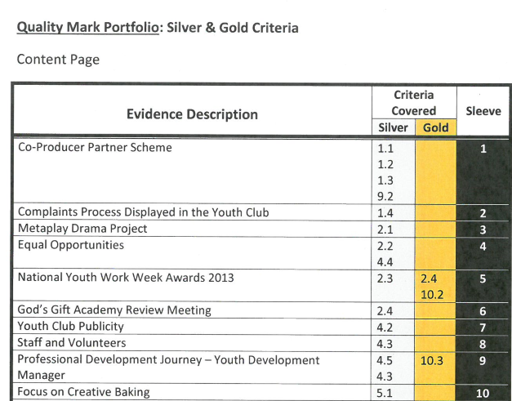
Referencing
Reference relevant indicator
Describe evidence piece

Slide 11
Referencing
Do you need to describe the evidence in more detail for it to make sense?

Slide 12
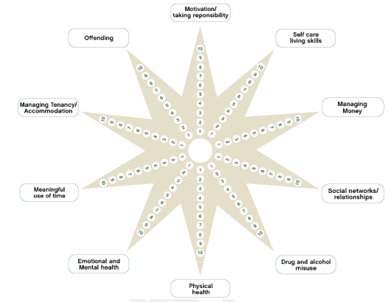
Outcomes for Young People
Key question is, whatever the toolkit, what are you measuring and why?

Slide 13
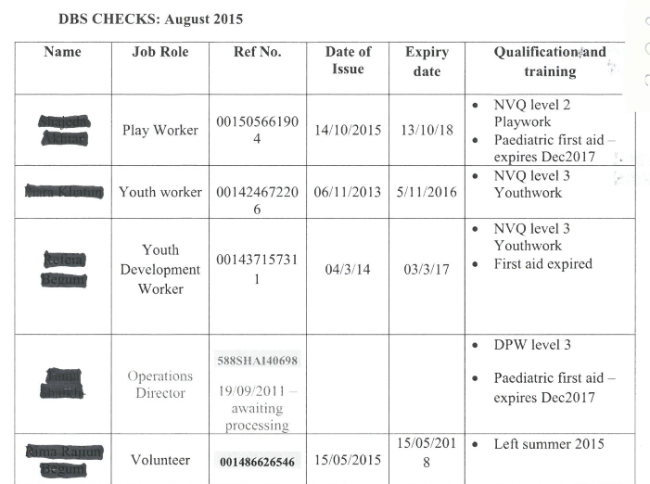
Safeguarding and Child Protection
Reference the DBS number

Slide 14
Safeguarding Policy Essentials
An overall statement of commitment (3.1B)
Definitions of neglect and abuse (3.1B)
Designated safeguarding officer named and has training (3.2B)
Procedure of reporting abuse (3.6B)
There should be a ‘Duty of Care’ statement (3.5B)
Outline procedures for dealing with allegations against staff or volunteers (3.8B)

Slide 15
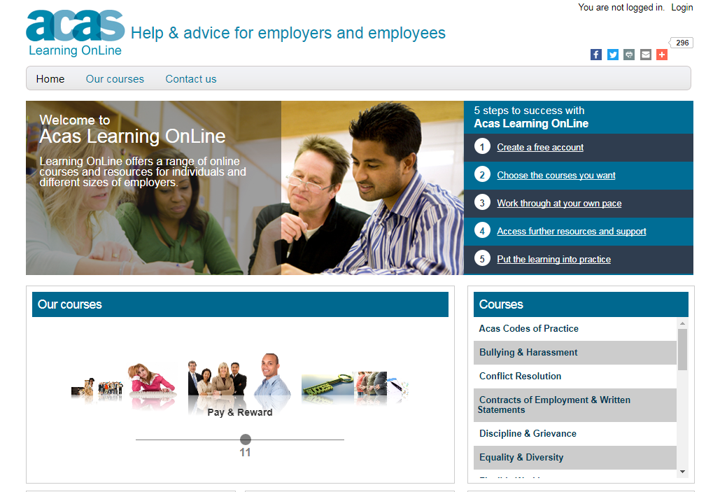
Diversity, Equality & Inclusion

Slide 16
Equal Opportunities Policy Essentials
Written reference to the Equalities Act 2010 and the 9 protected characteristics (4.1B)

Slide 17
Health & Safety Policy Essentials
Written reference Health and Safety Executive (6.1B)
Fire safety procedures outlined (6.2B)
Accident and incident reporting procedures (6.6B)
Adequate first aid procedures (6.7B)

Slide 18
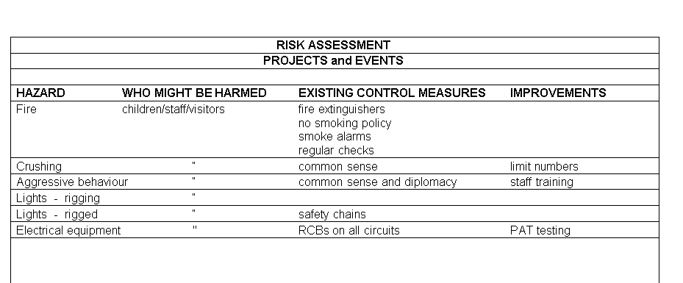
Health and Safety – Risk Assessments
Is this good enough?
What is missing?

Slide 19
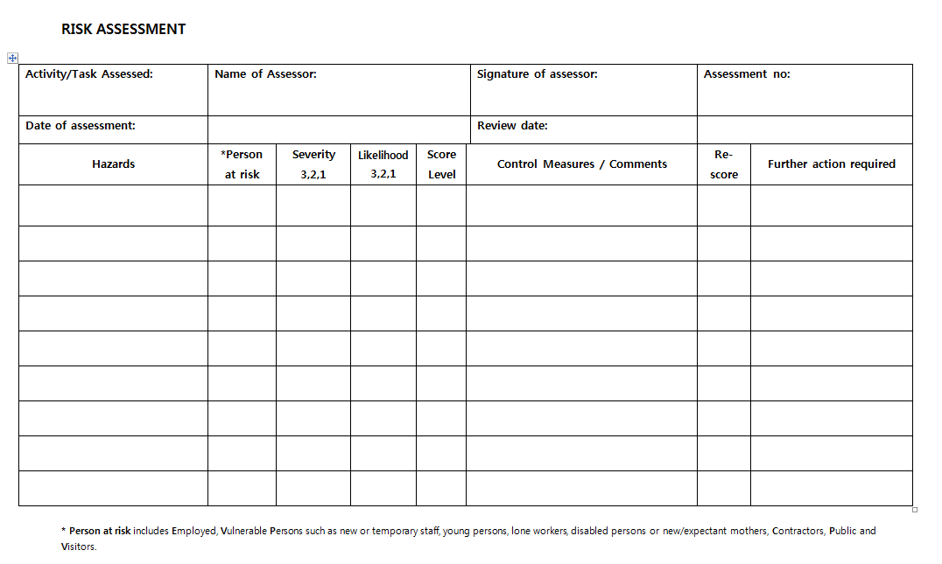
Health and Safety – Risk Assessments
Scoring is crucial
Re-score after control measures

Slide 20
Leadership and Management
#hashtag

Slide 21
Data Protection Essentials
You must provide evidence of a Data Controller registration certificate or confirmation that according to current ICO guidelines, this is not relevant to your organisation

Slide 22
Data Protection Policy Essentials
References the Data Protection Act 1998 and the General Data Protection Regulation (GDPR) (7.12B)
Outlines how you share, store, use and dispose of data (7.12B)

Slide 23
QM Process
Once the youth organisation has joined London Youth and has been provided with the QM indicators. They will need to:
Begin gathering their evidence (soft or hard copy)
Attend training workshops provided by London Youth
Attend a Quality Mark Workshop at 50% completion
Book a ‘Check-In’ with their Membership Development Officer when 80-90% complete
Undertake an assessment
3 year renewal process

Slide 24
Training
London Youth provides a variety of training workshops and 1-2-1 support to assist in the completion of the Quality Mark. The training currently provided are the following:
Impact Measurement & Evaluation
Improving Policies (Safeguarding + Health and Safety)
Intro to Equality and Diversity
Risk Assessments
Intro to Safeguarding
Building Manager
Designated Person Training (accredited)
Developing a Youth Board
Youth Mental Health

Slide 25
Who benefits from the QM?
Young People: They have an important role within the organisation and can participate in decision-making; they are made to feel welcome and valued; their opportunities for new experiences and for personal development is increased
Parents: Security and knowledge that staff are screened and trained in child protection policies and that the premises is safe. They will know that their child will have opportunities for personal development
Staff/Management: Increased awareness of the day-to-day running of the organisation; increased training opportunities; publicly committed to equality
External Partners/Funders: Their awareness that the organisation meets all legal requirements to provide a safe place for young people; their confidence that the organisation is functioning in the best interest of young people is increased
Community: Increased awareness of the organisation’s existence; developed a valuable and visible role in the local community; increased communication among parents, staff, members and management

Slide 26
Any questions?
#goodyouthworkworks

Slide 27
Keep in touch
@LondonYouth
@London_Youth
/LondonYouth
London Youth
Londonyouth.org/newsletter
Nicole Bristol-Robinson, Membership Development Officer
Nicole.Bristol-Robinson@londonyouth.org
020 7549 2964 or 07736 619608

